Slide 1
Real-Time twitter sentiment analysis
Team Member –
Aditya Ambadkar
Brajendra kumar Pathak
Mayank Goyal
Pravin kumar prajapati

Slide 2
Introduction
In an age driven by digital conversations, understanding the emotions and attitudes embedded within textual data has become paramount. Our project, "Real-Time Twitter Sentiment Analysis," embarks on a journey to decode the sentiments expressed in tweets and illuminate their significance.
Dataset Exploration: Leveraging the Sentiment140 dataset, we delve into sentiment analysis—an essential tool to decipher the sentiments conveyed by individuals on Twitter.
Machine Learning Diversity: Our endeavor spans the spectrum from traditional Logistic Regression and Naive Bayes to sophisticated Random Forest, SVM, and RNN-LSTM models.
Deep Learning Innovation: We harness the prowess of deep learning through Keras and Gensim's embeddings, unraveling the impact of these techniques on sentiment classification.
Web Application Unveiled: Taking our insights to the realm of accessibility, we introduce an interactive web application that empowers users to upload data, receive real-time sentiment analysis, and visualize results.

Slide 3
Dataset Analysis

Slide 4
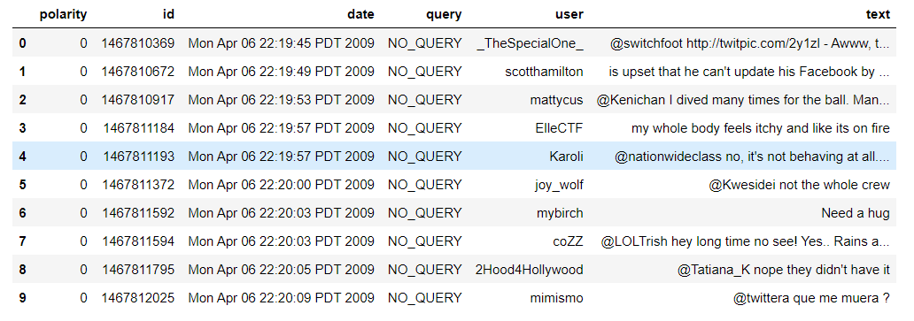
Dataset

Slide 5
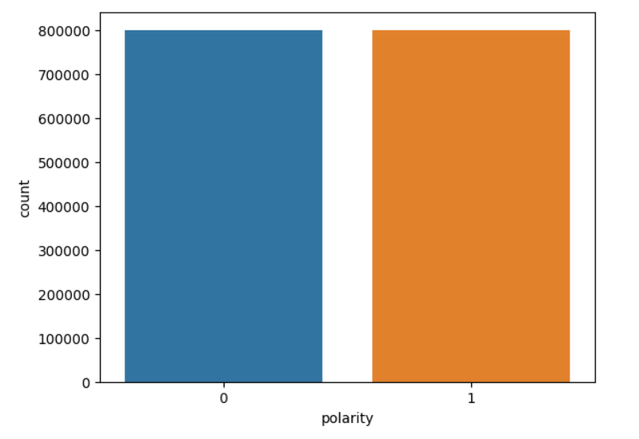
Sentiment Distribution

Slide 6
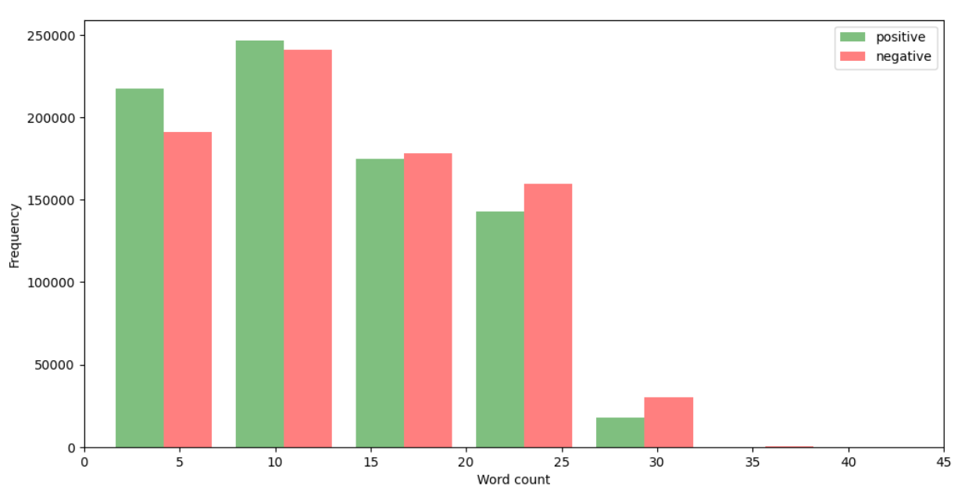
Word Count

Slide 7
Data cleaning and Preprocessing

Slide 8
Data cleaning
Text Cleaning: Special characters, URLs, and mentions are stripped from the text to distill the meaningful content.
Lowercasing: To ensure consistency, all text is converted to lowercase, mitigating potential discrepancies arising from letter casing.
Tokenization: Textual content is broken down into individual words, facilitating further analysis and processing.
Stopword Removal: Common words such as articles, pronouns, and conjunctions, often devoid of significant sentiment cues, are removed to focus on words with stronger emotional connotations.
Lemmatization: Words are transformed to their base or root form, maintaining semantic integrity and simplifying the dataset.
Numerical and Special Character Removal: Any residual numeric values or special characters are eradicated, leaving behind a text corpus devoid of extraneous elements.
Label Encoding: Polarity labels undergo transformation into binary labels ("0" for negative sentiments and "1" for positive sentiments), aligning them with the principles of sentiment classification.

Slide 9
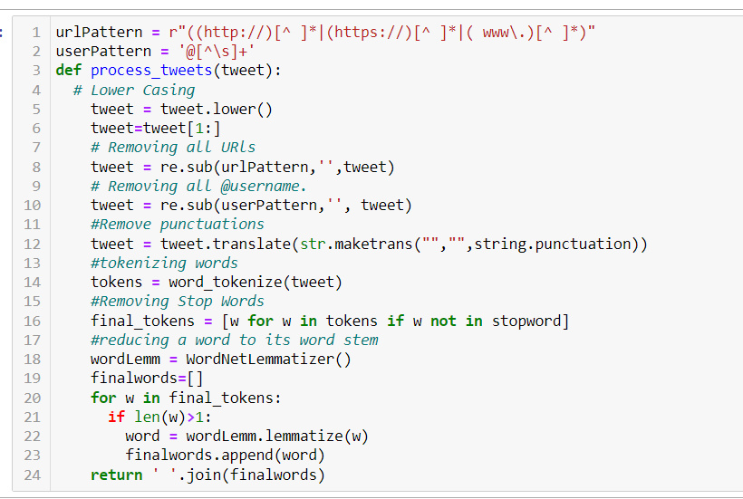
Data cleaning function

Slide 10
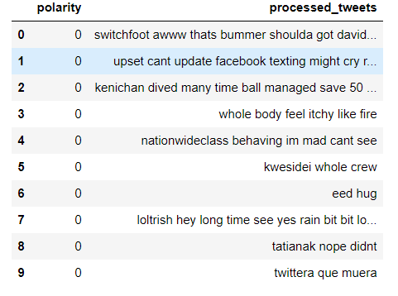
Cleaned Data

Slide 11
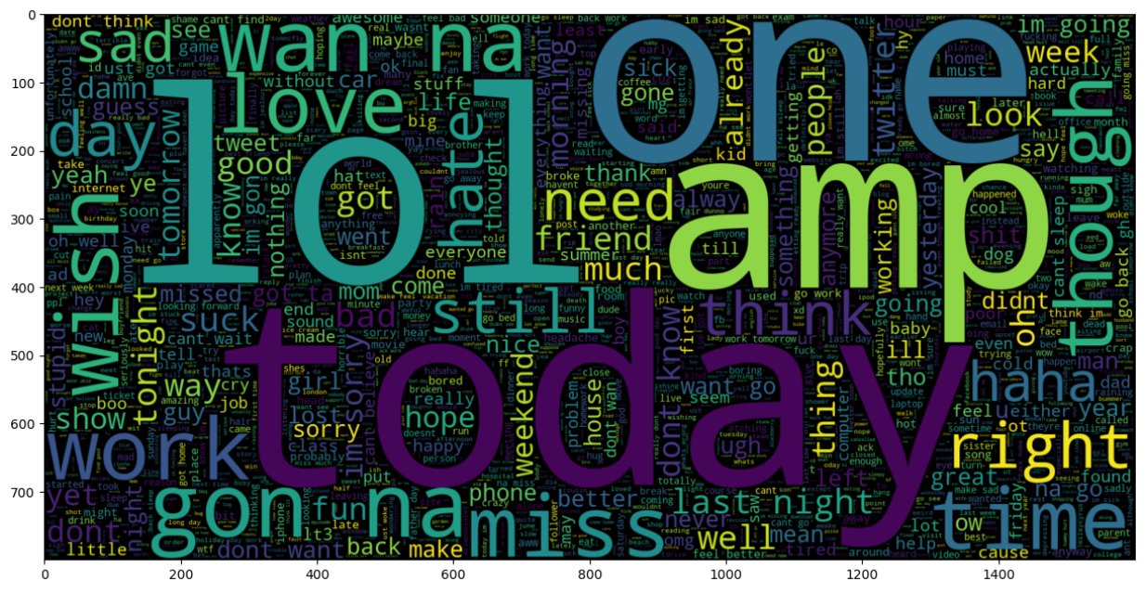
Negative WordCloud

Slide 12
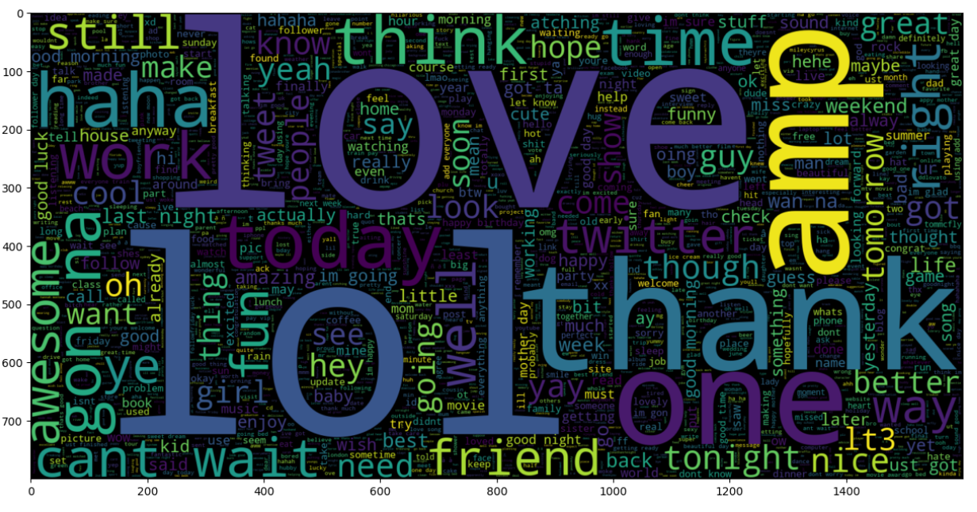
Positive Wordcloud

Slide 13
Model building and evaluation

Slide 14
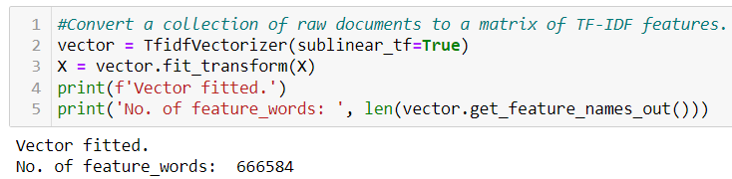
TF-idf vectorizer
TF-IDF: Term Frequency-Inverse Document Frequency.
Captures term importance in documents and corpus.
TF: Measures term occurrence in a document.
IDF: Measures term significance across the corpus.
TF-IDF = TF * IDF, balances term frequency and importance.
Benefits: Converts text to numerical vectors, aids in IR, classification, clustering.
Steps: Text preprocessing, initializing & fitting vectorizer, transforming documents.

Slide 15
Machine Learning models
Logistic Regression
Linear SVM
Random Forest
Naïve Bayes

Slide 16
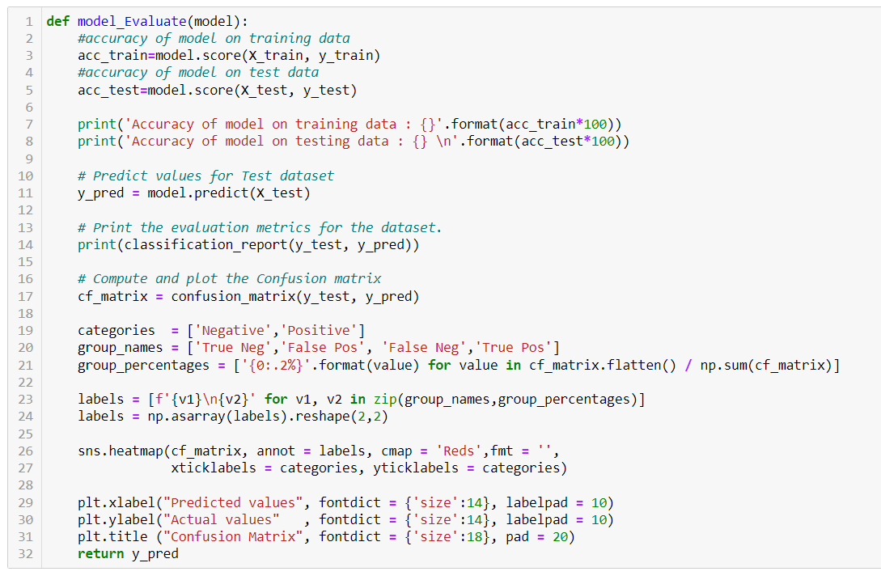
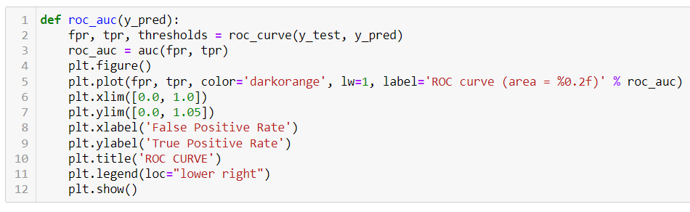
Model building and evaluation function

Slide 17
Logistic Regression
Model: Traditional statistical approach for binary classification.
Feature Transformation: TF-IDF vectorization to convert text into numerical features.
Evaluation: Accuracy, precision, recall, F1-score, and ROC-AUC metrics.
Insights: Logistic Regression serves as a baseline for sentiment prediction.

Slide 18
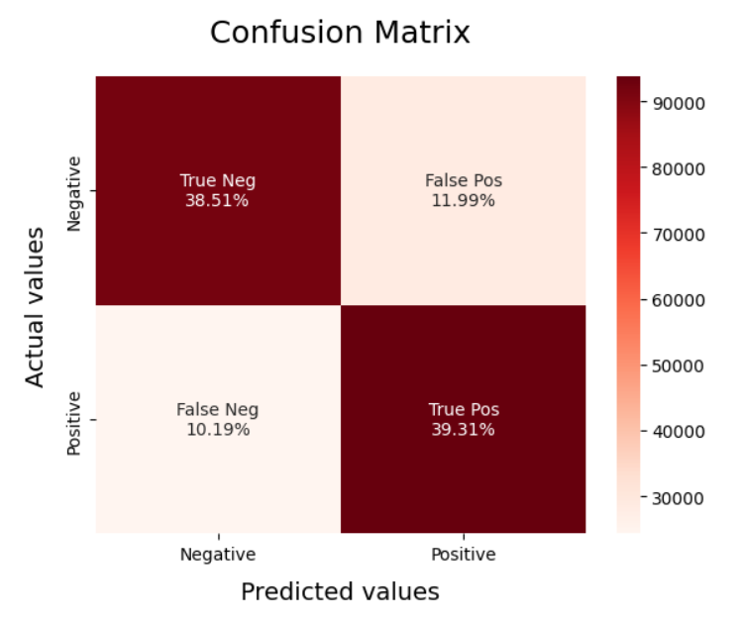
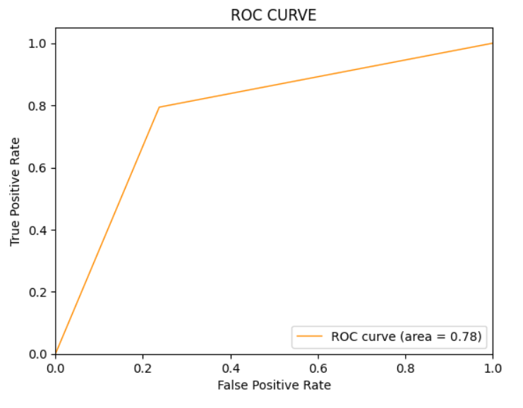
Logistic regression

Slide 19
Linear Support Vector Machine (SVM)
Model: Linear SVM for binary classification.
Feature Transformation: TF-IDF vectorization for text-to-numerical conversion.
Strengths: Effective in high-dimensional spaces, works well for text data.
Evaluation: Accuracy, precision, recall, F1-score, and ROC-AUC metrics.
Performance: SVM offers robust classification for sentiment analysis.

Slide 20
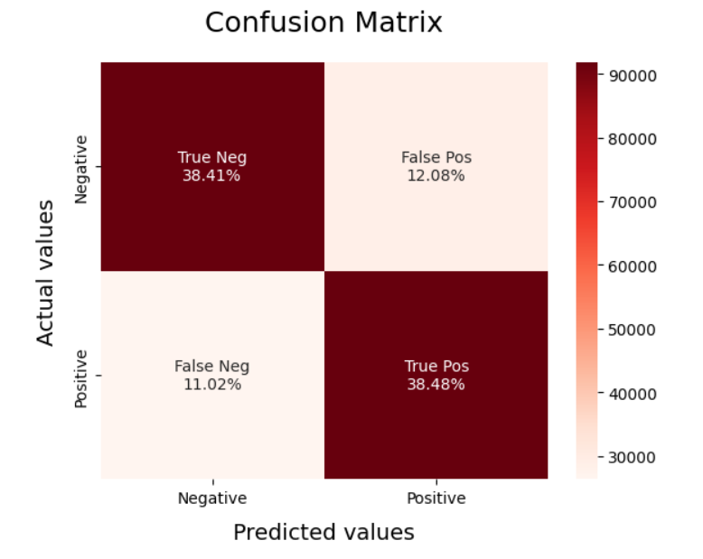
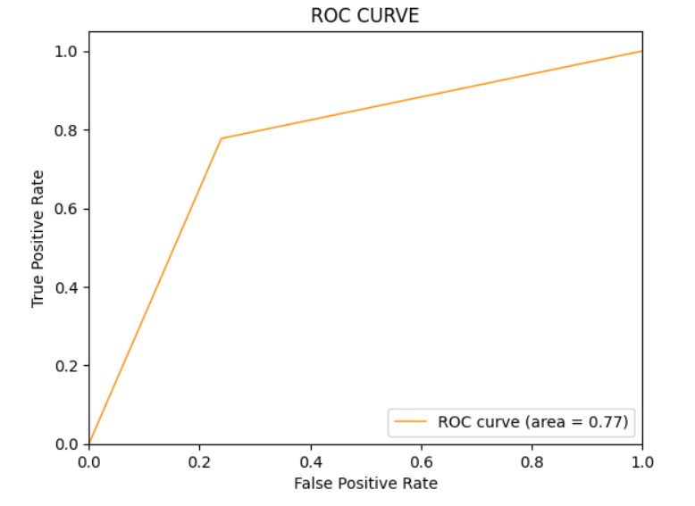
Linear svm

Slide 21
Random Forest
Model: Ensemble learning technique using decision trees.
Feature Transformation: TF-IDF vectorization for text-to-numerical conversion.
Advantages: Handles complex relationships, reduces overfitting.
Evaluation: Accuracy, precision, recall, F1-score, and ROC-AUC metrics.
Robust Ensemble: Random Forest provides robust sentiment classification.

Slide 22
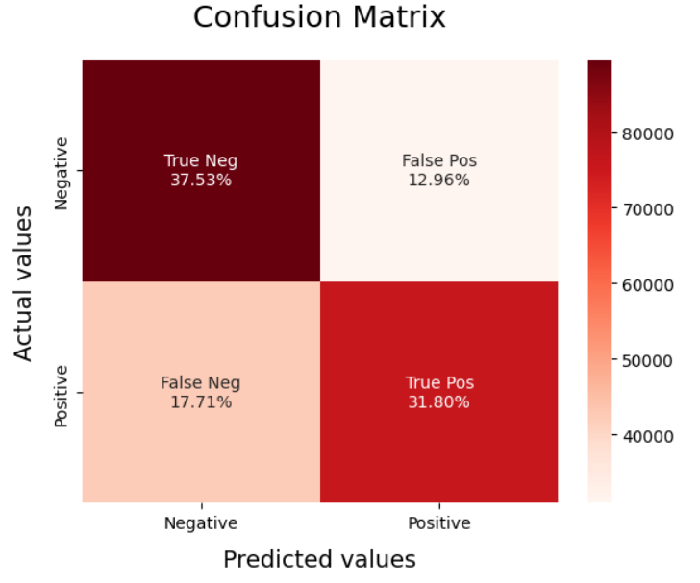
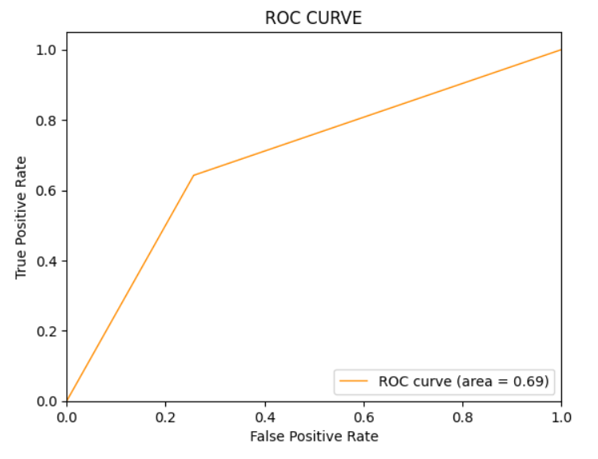
Random forest

Slide 23
Naïve Bayes
Model: Probabilistic classifier based on Bayes' theorem with independence assumption.
Feature Transformation: TF-IDF vectorization for text-to-numerical conversion.
Advantages: Fast training, works well with text data, handles many features.
Evaluation: Accuracy, precision, recall, F1-score, and ROC-AUC metrics.
Probabilistic Insight: Naive Bayes offers efficient sentiment prediction.

Slide 24
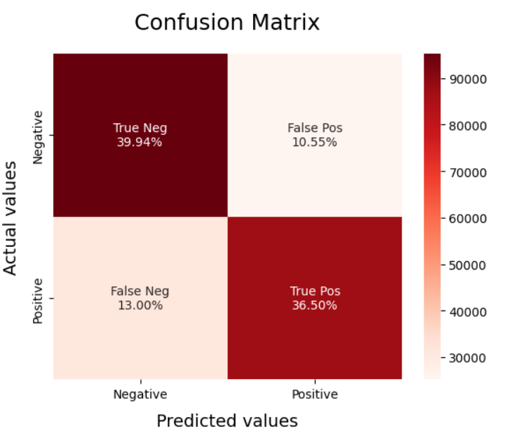
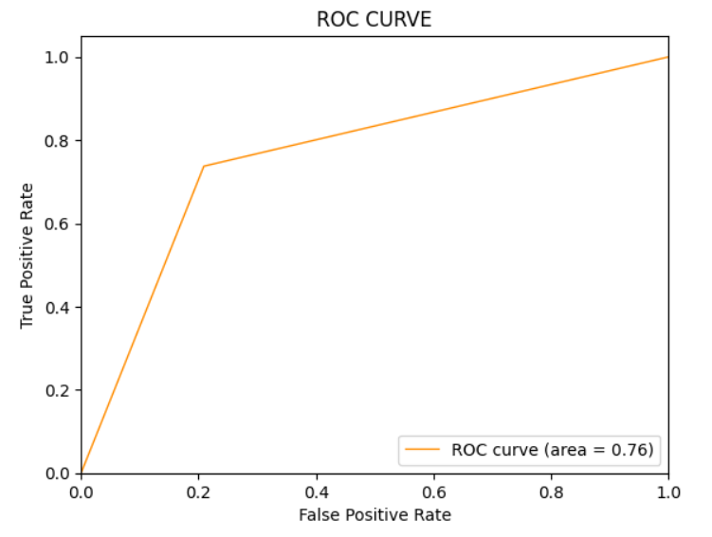
Naïve bayes

Slide 25
Deep learning models
RNN-LSTM Model
RNN-LSTM Model with Gensim Embedding

Slide 26
Rnn
Designed for Sequences: Analyze sequential data.
Feedback Loops: Information retention across steps.
Temporal Dependency: Context understanding in sequences.
Variable Length: Handles sequences of different lengths.
LSTM & GRU: Improved memory and vanishing gradient solutions.
Bidirectional RNNs: Utilizes past and future information.
Applications: NLP, time series, speech recognition.
Advantages: Sequential pattern recognition, stateful learning.
Challenges: Computationally intensive, vanishing gradients.
Key Role: Modern NLP and sequential data tasks.

Slide 27
lstm
Sequential Data Mastery: Specifically designed for sequences.
Memory Retention: Effectively captures long-range dependencies.
Gating Mechanisms: Three gates control information flow:
Forget Gate: Determines what to forget from previous state.
Input Gate: Decides new information to store.
Output Gate: Filters the current step's output.
Constant Error Flow: Overcomes vanishing gradient problem.
Applications: Natural language processing, speech recognition.
Advantages: Robust handling of sequences, reduced vanishing gradient.
Challenges: Complex architecture, higher computational demands.
Key Role: Dominant choice for sequential tasks.

Slide 28
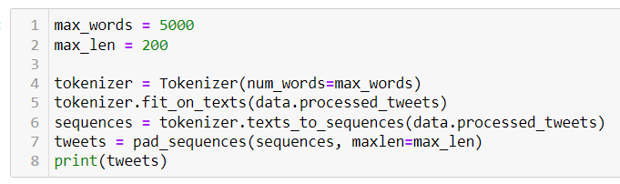
Tokenization and pad sequencing
Tokenization in Keras:
Utilizes Tokenizer class.
Converts text to sequences of integers.
Builds vocabulary and assigns unique IDs to words.
Padded Sequencing in Keras:
Ensures consistent input lengths.
Useful for neural networks requiring fixed input size.
Advantages:
Seamless integration with Keras models.
Handles tokenization and padding in a unified manner.

Slide 29
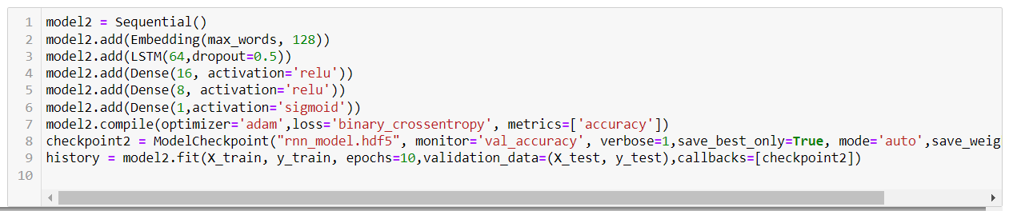
RNN-LSTM model

Slide 30
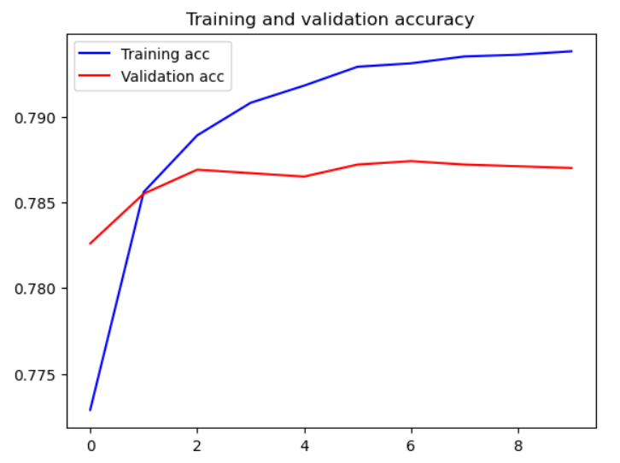
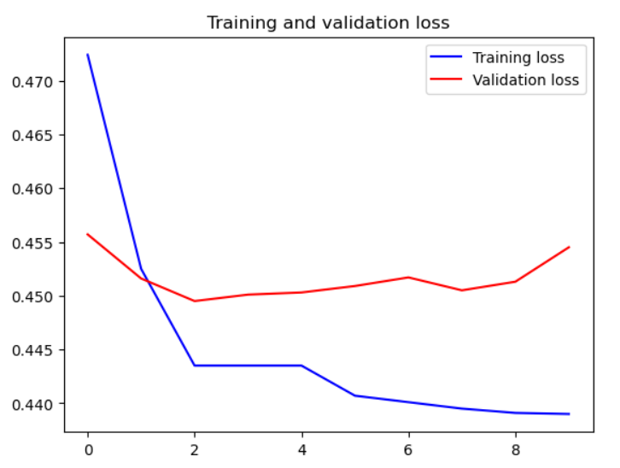
Accuracy and loss

Slide 31
Gensim word embedding
Gensim: Python library for text modeling and word embeddings.
Word Embeddings: Numerical representations of words.
Importance: Captures semantic relationships and context.
Word2Vec Model:
Creates word vectors based on context.
Two Architectures: Skip-gram & Continuous Bag of Words (CBOW).
Example:

Slide 32
Contd.
Key Parameters:
vector_size: Dimension of word vectors.
window: Context window size.
min_count: Minimum word frequency to consider.
Applications:
Natural language processing, information retrieval.
Improves model input quality.
Advantages:
Captures semantic meaning.
Enhances model understanding.
Challenges:
Requires substantial text data.
Can struggle with rare words.
Key Role:
Empowers NLP tasks with semantic-rich inputs.

Slide 33
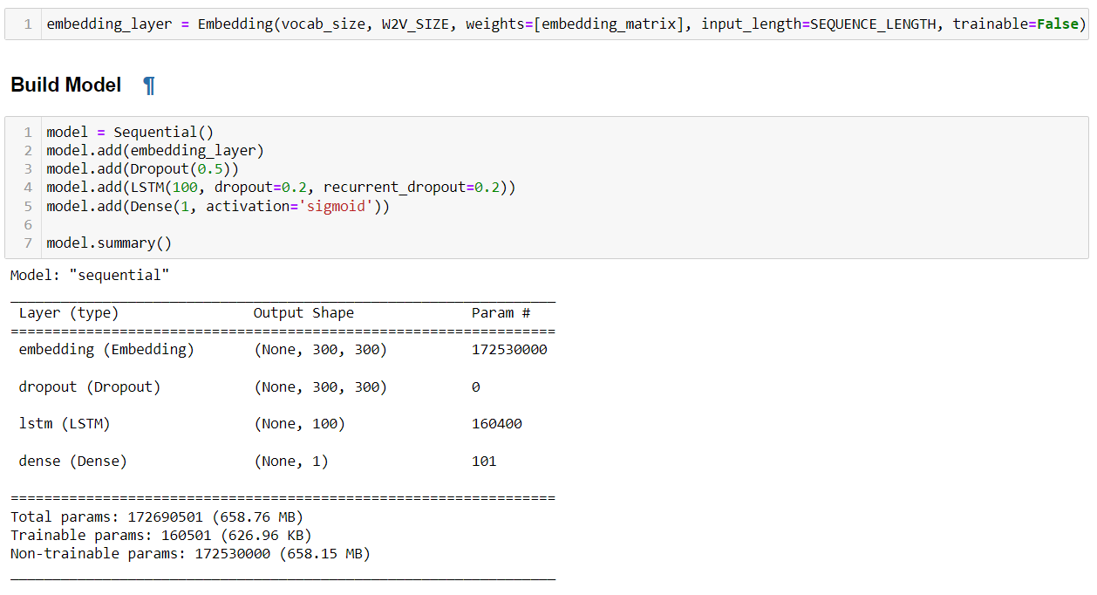
Rnn-lstm using genism embedding

Slide 34
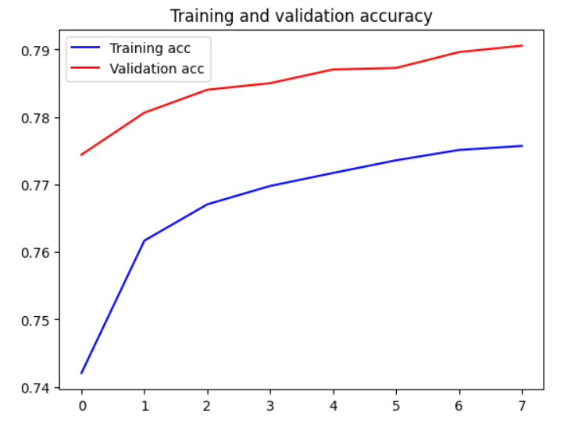
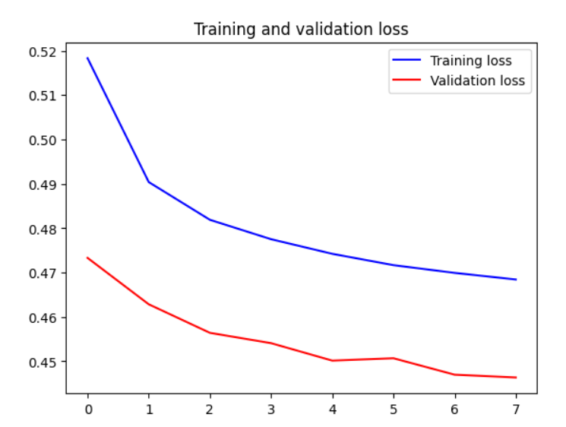
Accuracy and loss

Slide 35
Web application

Slide 36
Streamlit Library for Web App Creation
Simplify Web App Development
Streamlit Overview: A Python library simplifying the conversion of data scripts into interactive web applications.
Front-End Simplification: Eliminate the need for complex front-end development. Focus on functionality and analysis.
Interactive Elements: Incorporate buttons, sliders, charts, and widgets with ease for a seamless user experience.

Slide 37
User Interaction: Uploading CSV/JSON Files
Seamless Data Ingestion
Data Ingestion: Enable users to upload CSV or JSON files directly.
Seamless Integration: User-provided data seamlessly integrates into sentiment analysis process.
Prompt Data Processing: Real-time sentiment classification, offering instant insights.

Slide 38
Dashboard Overview
ALL Tab: Comprehensive view of sentiment categories.
POSITIVE Tab: Highlights of positive sentiment tweets.
NEGATIVE Tab: Insights into negative sentiment tweets.
Tab Navigation: Easy user navigation between sentiment views.

Slide 39
Visual Insights: Word Clouds
Language Patterns: Most Used Words
Word Clouds: Visual representation of frequent words.
Sentiment Focus: Different word clouds for each sentiment category.
Uncover Themes: Observe recurring terms in positive and negative sentiments.
Frequent Expressions: Most used words in tweets.
Contextual Understanding: Bigrams provide deeper context.
Informative Visuals: Charts showcasing common expressions.

Slide 40
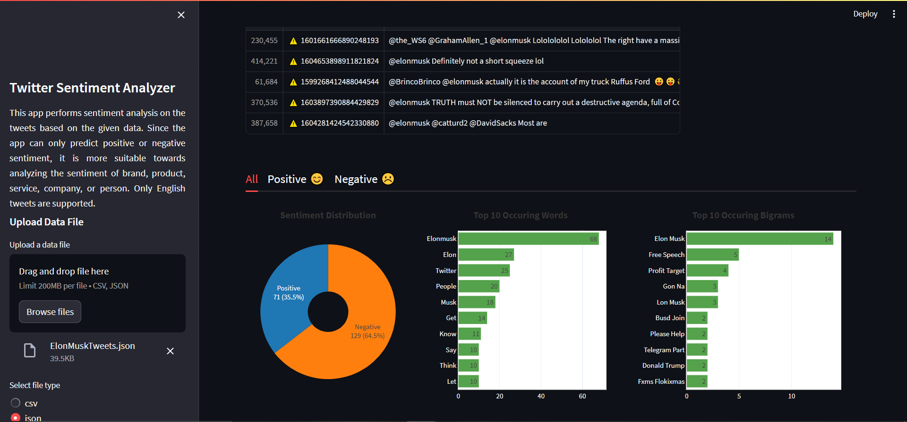
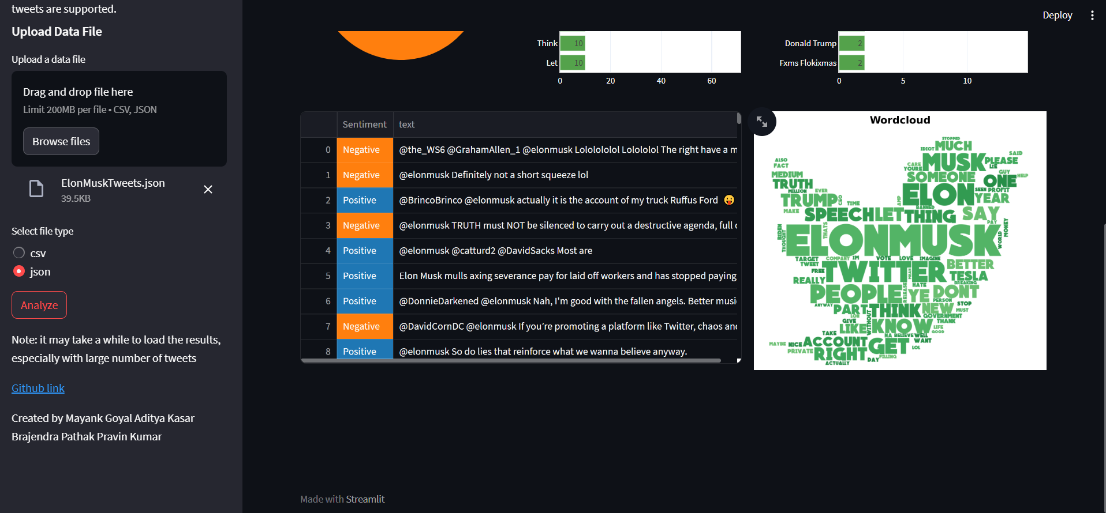
dashboard

Slide 41
Live demostration

Slide 42
Result and conclusion

Slide 43
Comparison of all models
Model | Accuracy
Logistic Regression | 78%
Linear SVM | 77%
Random Forest | 69%
Naïve Bayes | 76%
RNN-LSTM | 80%
RNN-LSTM with Gensim Embedding | 77%

Slide 44
Reflection on Significance
Business Insights: Decipher consumer sentiments for informed decisions.
Social Trends: Unveil public reactions, emotions, and societal trends.
Web App Impact: Practical application of sentiment analysis for users.
Cross-Domain Relevance: Applicable to marketing, academia, and beyond.

Slide 45
Project Limitations and Future Enhancements
Data Diversity: Adaptability to various contexts and languages.
Advanced Techniques: Attention mechanisms, transfer learning, ensembles.
Live-Time Integration: Incorporate live data scraping.
Multilingual Support: Extend application to global languages.

Slide 46
conclusion
Power of Sentiment Analysis: Unveiling emotions embedded in text data.
Bridging Data and Emotion: Insights from human communication.
Business Relevance: Informed decisions through sentiment understanding.
Ongoing Exploration: Project lays groundwork for future research.
Impactful Applications: Business strategies, social analysis, education, and more.

Slide 47
Thank you

